Slide 1

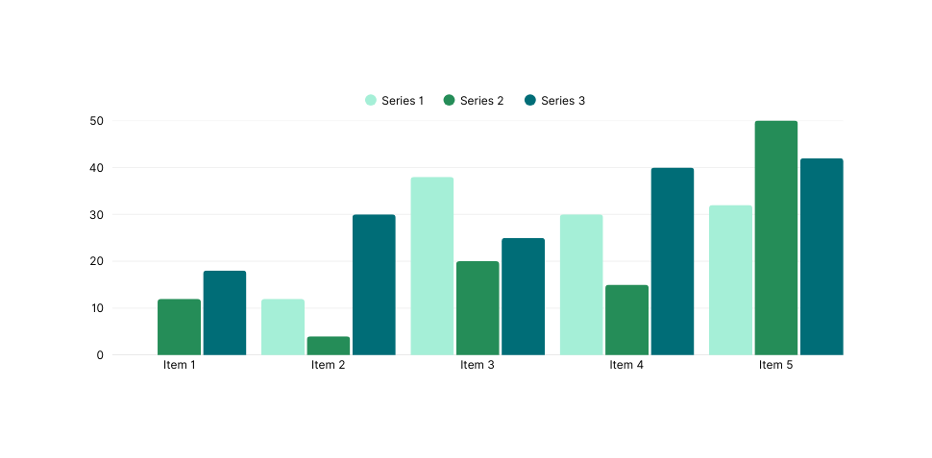


Authors-Affiliations
Title
Abstract
This research examines how technology improves student learning experiences. Results highlight increased motivation, active participation, and improved outcomes when digital tools are effectively integrated.
Introduction
Methodology
  Growing reliance on digital platforms in education
  Research focus: Impact of technology on learning effectiveness
  Significance: Shaping future teaching strategies
  Participants: 150 university students
  Approach: Surveys + classroom observations
  Tools: E-learning platforms, interactive quizzes, mobile apps
Result
  70% reported higher motivation with digital integration
  Participation increased by 30% in tech-assisted classes
  Data shows better performance compared to traditional settings
Discussion
Conclusion
Technology fosters active and collaborative learning, but challenges such as digital access and literacy remain. Institutional support is crucial for effective integration.
Technology enhances student learning by improving motivation and outcomes. Universities should invest in hybrid approaches and digital infrastructure to ensure long-term success.

